Slide 1
Study preparation
Selecting participants and
developing focus
Focus for brainstorming
Focus for rating
Utilization
Further consultation/prioritization
Program design and development
Needs assessment
Competencies
Program components
Program logic
Evaluation criteria
Statements generation
Individual brainstorming
Structured process for sharing and refining statements
Review of published literature
Map integration
Prepare pattern match plots
Go-Zone plots
Identify the ‘minimum meaningful’ and ‘maximum meaningful’ number of clusters for each map and the most typical statements for each
Statements representation
Pilling
Generate a point map using non-metric multidimensional scaling (MDS)
Statements structuring
Statements sorting
Statements rating
Map interpretation
Naming clusters
Identifying regions in the map

Slide 2

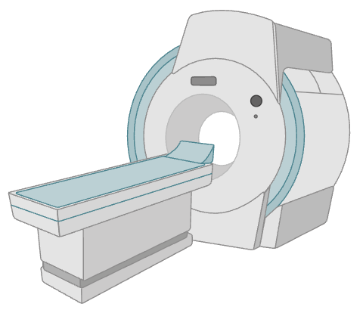



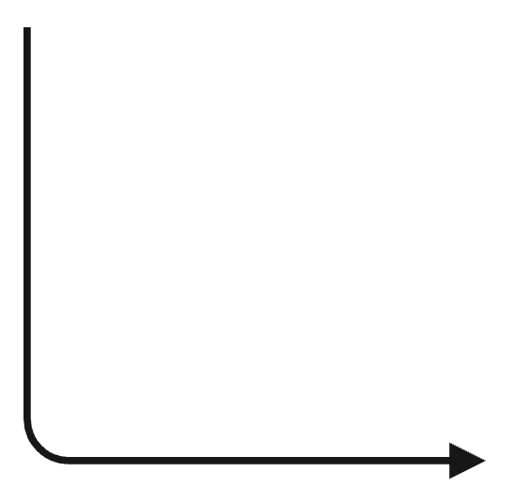




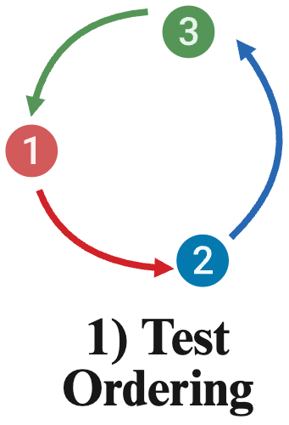


(i) Concepts Mapping Steps
(ii) Diagnostic Chain Workflow
Study preparation
Selecting the participants and developing the focus
Focus for brainstorming
Focus for rating
Utilization
Further consultation/prioritization
Program design and development
Needs assessment
Competencies
Program components
Program logic
Evaluation criteria
5) Image Interpretation
4) Image Acquisition
3) Test Protocoling
2) Test Scheduling
Statements generation
Individual brainstorming
Structured process for sharing and refining statements
Review of published literature
Map integration
Prepare pattern match plots
Go-Zone plots
Identify the ‘minimum meaningful’ and ‘maximum meaningful’ number of clusters for each map and the most typical statements for each
Statements representation
Pilling
Generate a point map using non-metric multidimensional scaling (MDS)
Statements structuring
Statements sorting
Statements rating
Map interpretation
Naming clusters
Identifying regions in the map
6) Report Generation
7) Report Communication
1) Test Ordering

Slide 3
5) Image Interpretation
4) Image Acquisition
3) Test Protocoling
2) Test Scheduling
6) Report Generation
7) Report Communication
1) Test Ordering

